Slide 1
Test Automation Engineering Fundamentals: Java
Module 5: Object-Oriented Design and
Principles

Slide 2
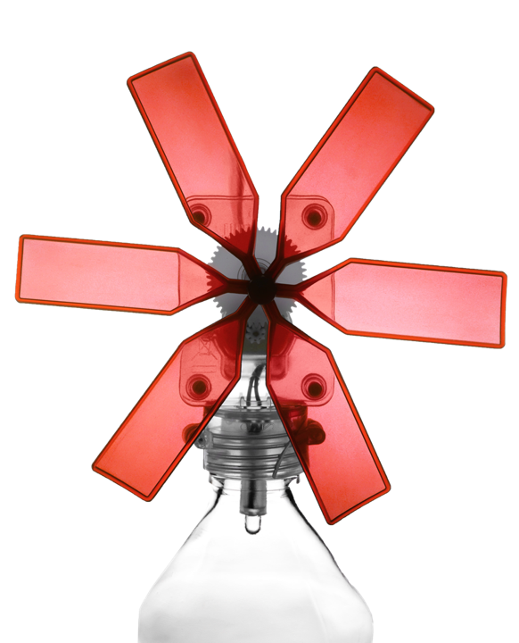
Module Objectives
At the end of this module, participants will be able to:
Define the concept of software abstraction in Object-Oriented languages
Describe the benefits of an outward-in approach when designing classes
Explain the principles of high cohesion and loose coupling in object design
2
Notes:
Key messages: This module is closely related to the topics in Encapsulation in greater context and detail. However, it focuses more on the principles.

Slide 3
Software Abstraction
Abstraction is the process of reducing or simplifying information or a concept in order to retain content relevant to the current context
Data is abstracted by high level language constructs, such as:
Numbers
Letters
Higher level data concepts
Functionality is abstracted by presenting interfaces that hide complex logic or algorithms, such as:
Functions
Methods
3
Notes:
Key messages:
High level languages provide facilities for declaring types that are more natural to us such as numbers, letters, characters instead of a format more natural to machines (binary 1s and 0s)
Further data abstraction can be seen from data structures that are built from multiple primitive types and higher level concepts such as dates, times, currency, etc.
A method or a function name and its return value/parameters are examples of a functional abstraction. It exposes only the name, parameters and expected behavior instead of lengthy and complex algorithm or group of statements.

Slide 4
Abstraction and Object-Oriented Programming (OOP)
An OOP language is built around the concept of a software entity called an object
An object is defined as the binding of data and the relevant functions and behavior exposed through a public interface
Objects communicate through the use of public interfaces and do not need to know the inner workings of other objects
Objects are based on classes, which are used to define the attributes and behaviors common to all instances of that class
Classes have hierarchies that define abstractions in their classifications
4
Notes:
Key messages:
Objects ‘communicating’ is a term used when objects invoke another object’s behavior. In human terms, an example can be a human can start a car by turning the key. Thus the human communicates the desire to start the car through an interface that is defined and accepted by both parties. The human does not need to know how the car works in order to start the car, nor does the car really care that it is a human turning the key.
The term ‘computer’ is a classification and an abstraction of the general properties of all objects that we know to be computers. It is a very general, broad term, but all computers regardless of type, brand, price etc… have the same general behavior and attributes.

Slide 5
Object-Oriented Programming (OOP)
Object orientation is a powerful means of expressing a problem domain and its solution, but it is still subject to limitations and pitfalls.
The mindset of an OO designer must be focused on creating small, simple re-usable components that can be combined to create more complex systems.
5
Notes:
Key messages: NA

Slide 6
Design by Interface
An OO designer needs to separate the concerns of behavior from the concerns of implementation.
It is a good principle to first define behavior by defining the interfaces that will be implemented by a class of objects.
Defining interfaces first imposes a mind-set of determining how the different objects communicate with each other.
Client objects should only be aware of the interfaces that are implemented by the objects they are dependent on.
The exposed interfaces should present parameters and return types that are not dependent on the implementation details.
6
Notes:
Key messages:
This is an expansion of the same topic in Encapsulation
Behavior is an abstract term that defines what an object is capable of doing. Implementation is the means by which the object achieves the behavior. When objects communicate, they are concerned with the former, but care little for the latter.
Some common pitfalls include designs that are too dependent on implementation. This leads to class designs that are too specialized and difficult to adapt and re-use in other situations. For example, an object with an interface that explicitly accepts database connections will forever be tied to that implementation. An interface should be insulated from the actual implementation of the object as much as possible.
Avoid using actual, concrete classes as references types in code, as this will lock your code to those classes. Use the relevant interfaces used by those classes.
Externalize aspects of an implementation might be interchangeable. Therefore, an interface should not be dependent on implementation. For example, the source of data for customer account might be an SQL, and XML, a text file or an XLS file. Ideally, client objects shouldn’t care where the data is coming from, and should be insulated from those details.
If interface is dependent on implementation. Then a parameter using an SQLConnection object, locks implementing classes to be dependent on a database implementation.

Slide 7
High Cohesion
It is important to remember that an object binds relevant data and behavior together.
A common pitfall in OO is designing an object to be able to do too many, possibly unrelated or loosely related things (low cohesion).
An object exhibits high cohesion if all of its behavior is strongly related within the context of the object’s overall functionality.
The functionality of the object itself must be designed with a very focused and specific goal.
7
Notes:
Key messages: NA

Slide 8
Loose Coupling
An object is loosely coupled with another object when:
Is a natural result of high cohesion and designing by interfaces
A change in one object does not necessitate a change in the other
An object does not require knowledge of the specific implementation, that it is dependent on, in order to function
8
Notes:
Key messages:
A good test is seeing if a change in one of the dependencies creates ripple effects in the client. For example, Object A uses Object B to retrieve data. Object B currently retrieves data from a database. A change in the design necessitates that Object B now retrieves the same data from an XML file. If Object B can be re-implemented without having to re-implement Object A, then the two are considered ‘loosely coupled’

Slide 9
Code by Interface
Interface Implementation 1
Client Application
public execute(Details){
//actual implementation
…
}
Interface conn =
factory.retrieve();
conn.execute(details);
implements
Interface
Mock Implementation
public execute(Details)
public execute(Details){
//fake data for testing
…
}
references
implements
Interface Implementation 2
public execute(Details){
//actual implementation
….
}
implements
9
Notes:
Key messages:
In this diagram the client Application is only aware of the interface. It is not aware, nor does it care about the different possible actual implementations. The client application is shielded from the details of the different implementations, and will not have code that is specific to each kind of implementation. Its only concern are two behaviors specified by the interface. The implementation can switch without having to modify the client application. This makes for a ‘pluggable’ architecture that is highly customizable and maintainable.
There is often some kind of abstraction mechanism or framework utilized by the client applications to retrieve instances of the implementing classes it requires. Examples of this are Spring dependency injection framework, EJBs calls, etc.

Slide 10

Questions and Comments
What questions or comments do you have?
10
Notes:
Focus: Questions and Comments
Key messages: NA
Note to Instructor: Ask participants for any questions or comments they may have.
Transition: This brings us to the end of this module.

